Slide 1
Booting from hard disk…
Starting Windos 98…
Start now

Slide 2


Slide 5

explorer

Slide 6
Internet explorer 22.5:

Slide 8
Welcome to Windos 98!
Welcome to Windos 98.
Close the window to start the welcome tour!

Slide 9
Welcome!
Welcome to Windos 98!
This version is improved and looks like windows 7!
Close to proceed

Slide 10
Welcome!
Please enter your username:
username
>

Slide 11
Welcome!
Please set a password to use the computer with:
>

Slide 12
Security alert
Setting the password to a blank one is not recommended. Please close the window to go back and press proceed to ignore this window

Slide 13
Welcome!
Please wait as we setup the system…
100% complete

Slide 14
Welcome!
Please close the window.
Setup has complete.

Slide 15
update
Please close the window to install the updates necessary to your system.
You need an internet connection to proceed.

Slide 16


Slide 17
updates
Have been completed.
Please close and logon!

Slide 18
logon
Please press sign in, Username!
Sign in

Slide 19
What’s new:
Underlined what’s new text
Worked on indexing C:\
Added website that lets you access drive C
Added shell32.dll to store all icons
Added bin. As a placeholder it does nothing when clicked on
Added access to new power menu
bin
Windos 98
Alpha 2
for test purposes only

Slide 20
Clippy is not working!
Please update to fix the issue
Shortcuts:
Computer
All Apps
Power…
IE225

Slide 21

Internet Explorer 22.5
Reconnect here

Slide 22
Internet Explorer 22.5
Reconnecting. ..
complete

Slide 23
Internet Explorer 22.5; connected; DNS 1.1.1.2; IP address 112.12.12.345; connection speed is 10mbps; up to date browser;
DNS protocol is HTTPS; internet is secured by TSL encryption; cookies enabled; 1000 cookies stored in browser; this site uses 10 cookies; Internet Explorer was made by M1cr0$0ft in 2020. the successor of 3dg3.
Welcome to the Internet!
Please select one of these sites:
Get aCCe55

Slide 24
computer
No readable disks inserted
Please update to see if C:\ Is added!

Slide 25


All apps
IE22.5
Email 2.02

Slide 26
Email client
V2. 02
For Windos 98
© 2020 M1cr0$0ft c0rp.

Slide 27
Email client v2.01 - inbox
It is empty! :)

Slide 28
Power off
Power off
Reboot
Sign out
Sleep
Crash system

Slide 29
Crash system
Click outside of window to cancel.
Close window to accept

Slide 30
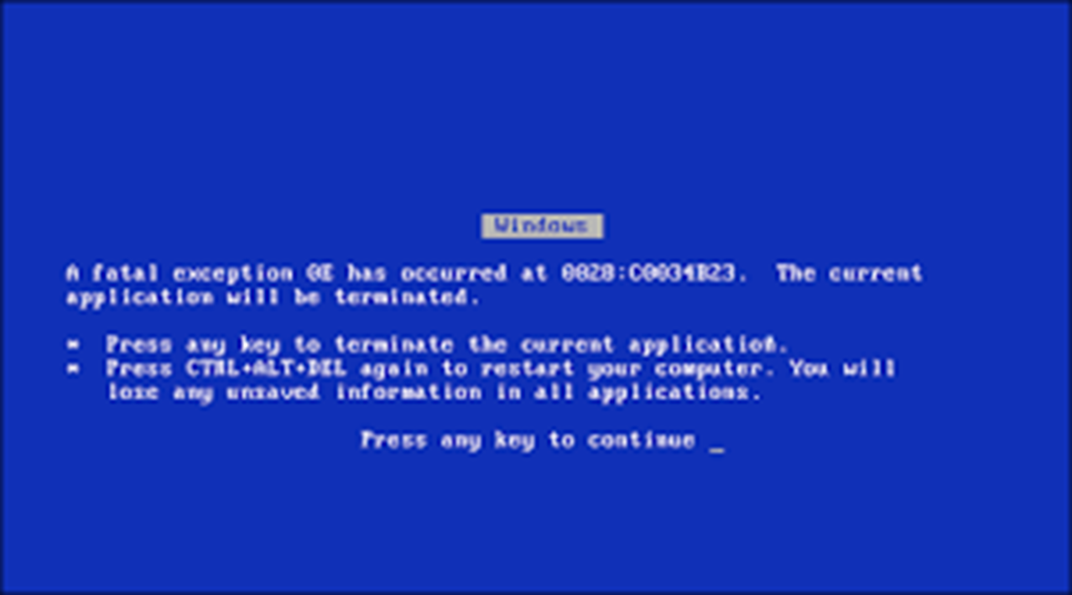

Slide 31
It is now safe to turn off this PC
Press ESC to turn off
reboot

Slide 33
Internet explorer 22.5:get aCCe55
Hey!
Click on da link 2 aCCe55 drive C if it is hidden in your version!
BTW the drive may not be 1nd3x3d s0 u m4y h4v3 2 w41t Unt1l 1t 1s Unh1dden 2 C da full d1sk!
Get aCCe55

Slide 34










explorer
C:\Windos\shell32.dll

Slide 35

explorer
C:
Windos
Username
admin
SYSTEM
windos.exe
Welcome.exe
Explorer. exe
bin

Slide 36
explorer
C:\windos
system32
winSxS
war
shell32.dll

Slide 37
Access denied!
The system does not let you access that!
This is to protect the system
Click outside to exit

Slide 38
Access denied!
The system does not let you access other user folders!
This is to protect their privacy!
Would you like it if someone looked at your documents?
Click outside to exit

Slide 39
Access denied!
The system does not let you access your user folder!
This is to prevent hackers from accessing your files
Thank us later for the security!
Click outside to exit

